Slide 1

Smart Event Management
Web Application
JINA HWANG
MINKYEONG KANG

Slide 2

Technology Stack Selection
Category | Selected Technologies | Why ? | Why not ?
Frontend | HTML, CSS (Bootstrap) | Bootstrap: Enables rapid UI development with pre-built components. | Tailwind CSS: Requires more manual styling and increases development complexity compare to Bootstrap.
 | Django Templates (JavaScript) | Django Templates: Allows easy integration between frontend and backend. | React.js: Adds unnecessary complexity such as API integration and state management beyond the project scope.
Backend | Python (Django) | Batteries Included: Built-in Auth, Admin Panel, and ORM to meet tight deadlines. | Node.js: Requires manual setup for basic features like admin panels and security.
Database | PostgreSQL | Data Integrity: Essential for ACID transactions in payments and capacity management. | MongoDB: Less suited for strict consistency needed in financial and inventory systems.

Slide 3
Main Functionalities to Develop for Event Organizers
Event Lifecycle Management : Tools to create, configure, and update events, including date/time, capacity, pricing, and event format(physical, virtual or hybrid).
Attendee & Ticket Tracking : Tracking attendee registrations and ticket sales.
Communication System : Messaging system for communicating updates and important information to attendees.
Performance Monitoring : Monitoring event performance based on bookings, ticket sales, and user feedback.

Slide 4
Main Functionalities to Develop for Attendees
Discovery & Search : Ability to browse and search events by category, location or date.
Booking & Ticket Purchase : Secure authentication and efficient ticket booking process.
Notifications & Reminders : Automated notifications and reminders regarding schedule changes or cancellations.
Feedback System : Submission of ratings and reviews after event participation.

Slide 5
Main Functionalities to Develop for Admin
Platform Management : Management of all users, events, and overall platform operations.
Transaction Monitoring : Tracking payments, ticket sales, and booking activities.
Reporting & Analytics : Generating reports and statistics for platform usage and event performance.
Waitlist Management : Handling high-demand events with limited capacity through waitlist functionality.

Slide 6
Initial Architecture & Design Decisions
Architecture : Web-based system built using Django backend and PostgreSQL database.
Database Design : Relational structure managing users, events, bookings, payments, and reviews.
Event Structure : Supports physical, virtual, and hybrid events through structured attributes.
Core Features : Event management, ticket booking, payment tracking, and user feedback.
Extended Features : Notifications, waitlist handling, event updates, and messaging system.
Future Extensions : Real-time updates and advanced authentication considered for future implementation.

Slide 7
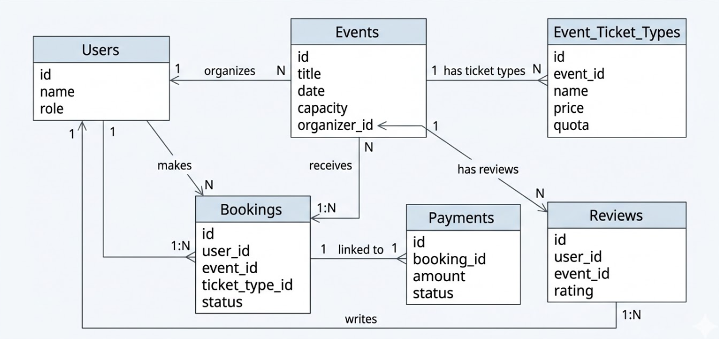
Data Model (ERD)
Core Entities : Users, Events, Bookings, Payments, Reviews
Key Relationships : Users can create events and make bookings, while events manage ticket types and reviews.

Slide 8
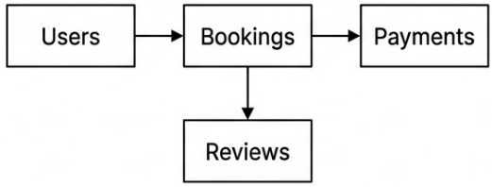
Database (PostgreSQL)
Core Design Principles
Relational Structure
Data Integrity
Functional Separation
Scalability
Key Implementation Logic
Separate Bookings & Payments
Event Capacity Control via Booking Records
Waitlist for Full Capacity Events
Extension Tables for Additional Features
Example Constraint
UNIQUE(user_id, event_id)
Prevents duplicate bookings by the same user for the same event.

Slide 9


